Slide 1

Nuzvidu

Slide 2
TRAFFIC SIGN RECOGNITION
Under the guidence of :-
Mrs. M. Baby Anusha
(Assistant Professor of CSE)
Submitted by : -
N180490 – S.Manjulatha

Slide 3
Abstract
Traffic sign recognition is a vital component of intelligent transportation systems, enabling vehicles to recognize road signs.There are several different types of traffic signs like speed limits, no entry, traffic signals, turn left or right, children crossing, no passing of heavy vehicles, etc. Traffic signs classification is the process of identifying which class a traffic sign belongs to. As the automotive industry advances towards autonomous driving, traffic sign recognition remains a critical aspect to ensure seamless integration and safer journeys for all road users. I have build a deep neural network model that can classify traffic signs present in the image into different categories. With this model, we are able to read and understand traffic signs which are a very important task for all autonomous vehicles.

Slide 4
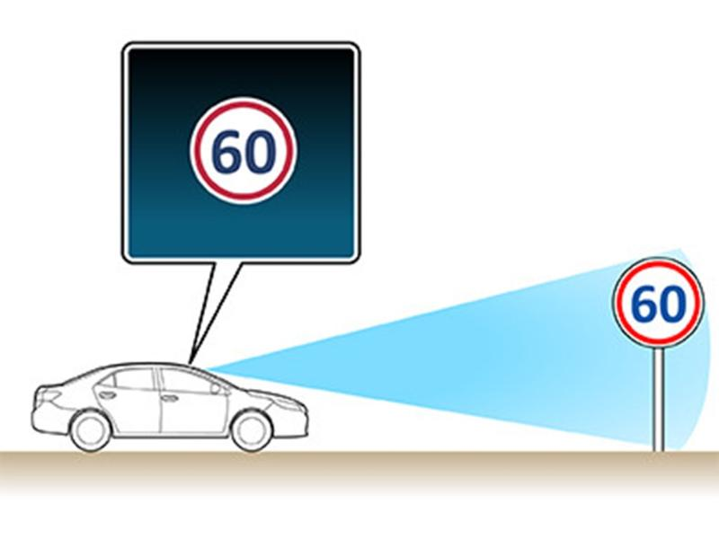
Introduction
This project focuses on developing a state-of-the-art traffic sign recognition system using machine learning and deep learning techniques. The primary goal is to enhance road safety by enabling vehicles to autonomously detect and interpret traffic signs in real-time. Through advanced algorithms and neural networks, the project aims to contribute to the evolution of intelligent transportation systems.
Motivation
The motivation behind this project is to reduce road accidents caused by human error and ignorance of traffic signs. By implementing an accurate and efficient traffic sign recognition system, we aim to bolster driver assistance technologies and move towards a safer and more reliable autonomous driving future. This project's success could significantly contribute to reduce road risks and enhancing overall transportation safety.

Slide 5
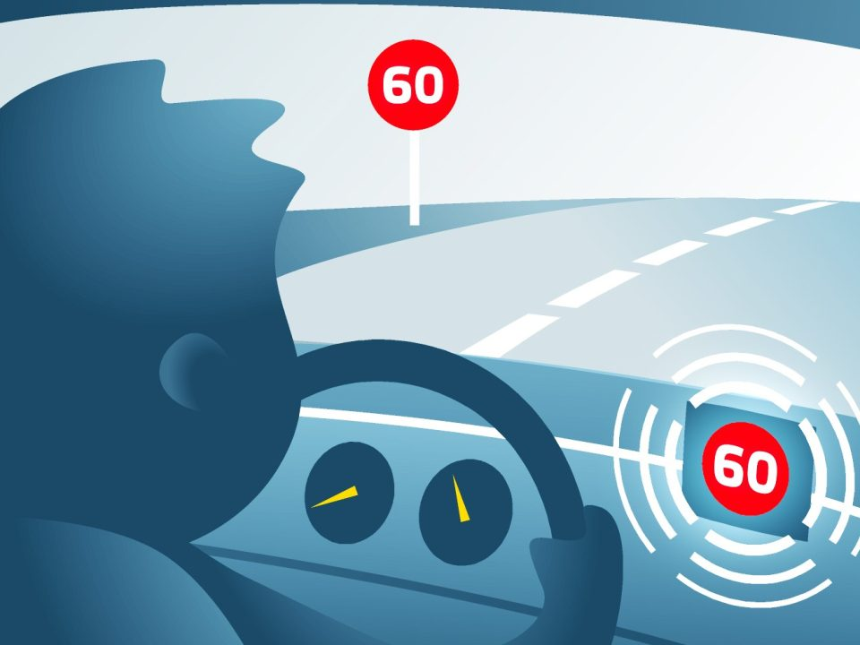
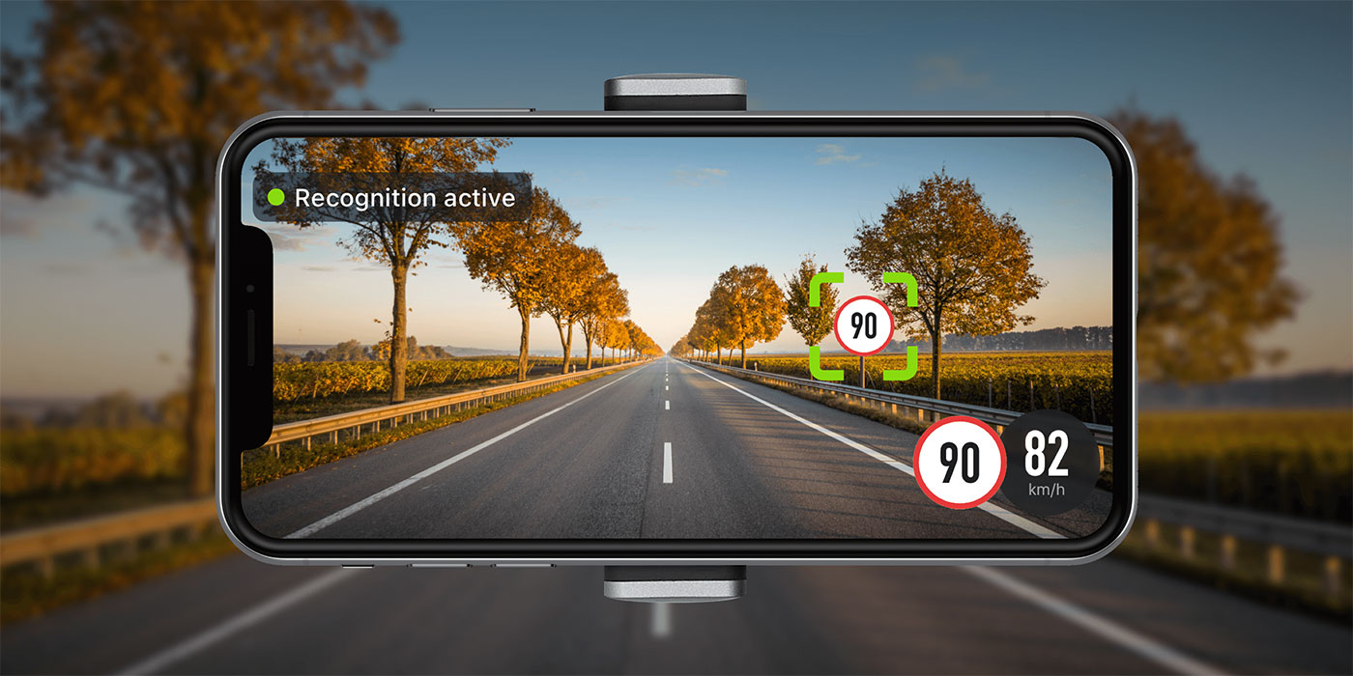
Applications
Advanced Driver Assistance Systems (ADAS) in modern vehicles for improved safety and driver convenience.
Autonomous vehicles rely on traffic sign recognition to navigate roads and obey traffic rules.
Smart city infrastructure uses traffic sign recognition to optimize traffic flow and reduce congestion.
Traffic police and law enforcement agencies can benefit from automated traffic sign monitoring .
Delivery companies can enhance route planning and adherence to traffic regulations.
Road maintenance and construction crews can use traffic sign recognition to assess and update road signage accurately.
Augmented reality navigation apps can use this technology to provide real-time information to drivers

Slide 6
Existing System
Existing systems for traffic sign recognition include Mobileye, Tesla Autopilot,, Bosch Traffic Sign Recognition, and various mobile apps like Waze and Google Maps.
These systems employ computer vision and AI technologies to detect and interpret traffic signs, aiding in advanced driver assistance and autonomous driving capabilities.
However, the field is continuously evolving, and newer systems may have emerged.

Slide 7
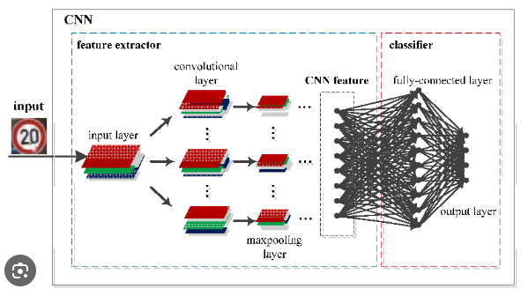
Algorithm
Convolutional Neural Networks (CNNs) in traffic sign recognition use a hierarchical approach to automatically learn and identify traffic signs from images. They efficiently extract important features by applying convolutional filters, reducing the dimensionality of the input data. This enables CNNs to detect complex patterns, such as shapes, colors, and edges, critical for accurate sign classification. With their shared weights and pooling layers, CNNs learn to recognize invariant features, making them robust to variations in scale and orientation. These efficient properties make CNNs highly effective for real-time traffic sign recognition tasks, enhancing road safety and automation.

Slide 8
Algorithm
1. Procedure CNN_Traffic_Signal_Recognition(Input_Data, Num_Epochs,
Batch_Size)
2. Import necessary libraries and datasets
3. Preprocess the input dataset (e.g., resizing images, normalization)
4. Split the dataset into training and testing sets
5. Create a CNN model
6. Train the CNN model using the training dataset for Num_Epochs epochs and
Batch_Size batch size
7. Compile the CNN model with loss='categorical_crossentropy optimizer='adam'
and metrics=['accuracy']
8. Evaluate the CNN model using the testing dataset
9. Calculate and store metrics (e.g., accuracy, confusion matrix) for performance
evaluation
10. End procedure

Slide 9
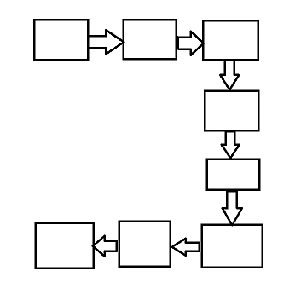
Plotting graphs for accuracy
Architecture
Exploring traffic signs dataset
Building the CNN model
Train and validate the model (15 epohs)
94%
accuracy
Result
Recognize image
Upload
image

Slide 10
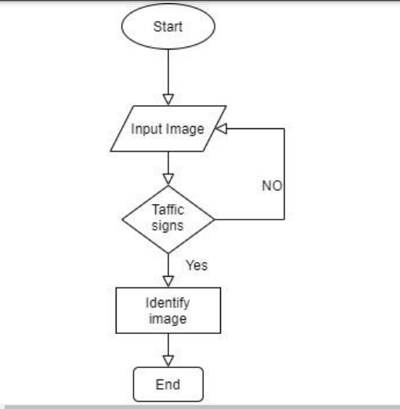
Flowchart

Slide 11
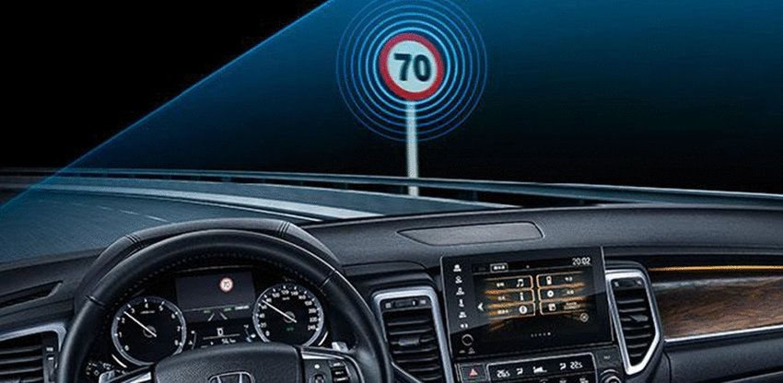
Components in proposed system
This project is developed using deep learning. I am getting to develop a model which can detect the traffic sign. I have build deep neural network model which will identify which traffic sign is present therein image.
I also used PIL library to open image content into array.
The dataset contain train folder which carries folder each represents different classes and in test folder we've the image path and their respective class labels.
A convolutional neural network is a class of deep learning networks, used to examine and check visual imagery. It is used to train the image classification and recognition model because of its high accuracy and efficiency. it understands complex pattrens from large dataset and do automatic feature extraction.

Slide 12
Required Libraries
numpy
pandas
matplotlib.pyplot (matplotlib)
tensorflow (tf)
PIL (Python Imaging Library)
os
sklearn.model_selection (train_test_split)
keras.utils (to_categorical)
keras.models (Sequential, load_model)
keras.layers (Conv2D, MaxPool2D, Dense, Flatten, Dropout)
pathlib (Path)

Slide 13
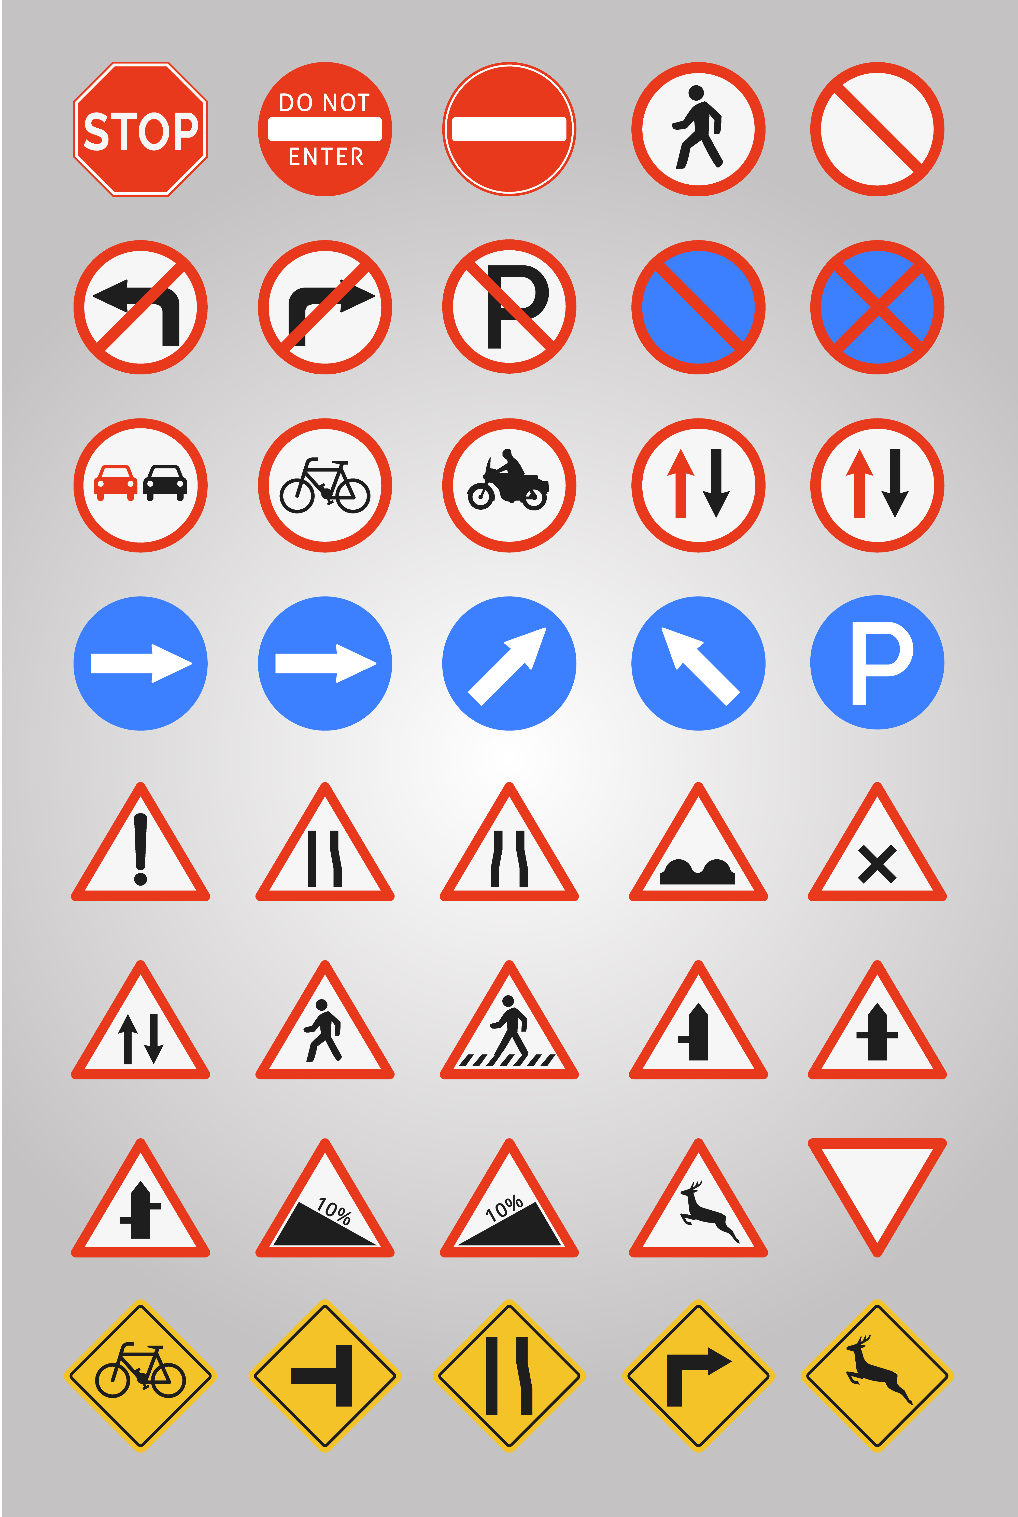
Dataset: GTSRB - German Traffic Sign Recognition Benchmark
For this project, I have used the public dataset available at Kaggle.
The dataset contains more than 50,000 images of different traffic signs. It is further classified into 43 different classes. The dataset is quite varying, some of the classes have many images while some classes have few images. The size of the dataset is around 300 MB. The dataset has a train folder which contains images inside each class and a test folder which we will use for testing our model.

Slide 14
System Specifications
Hardware:
Processor : CORE i3
RAM : 4 GB or Higher
ROM : 100 GB or Higher
OS : Windows 8 or high
Software:
PYTHON
Jupyter Notebook
Tkinter
Visual studio code
.

Slide 15
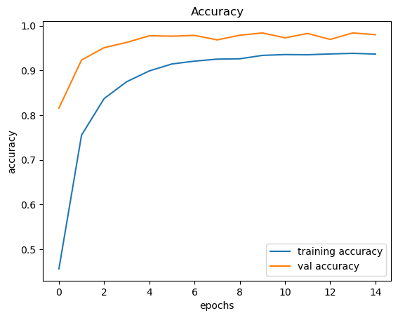
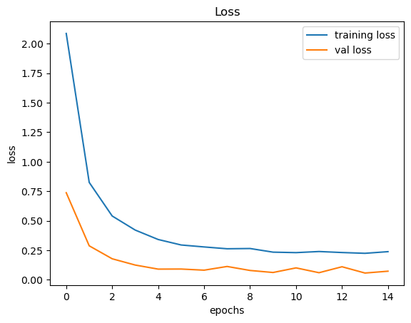
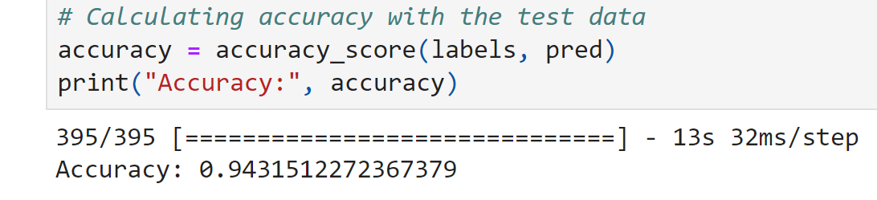
Accuracy
Loss
Accuracy

Slide 16
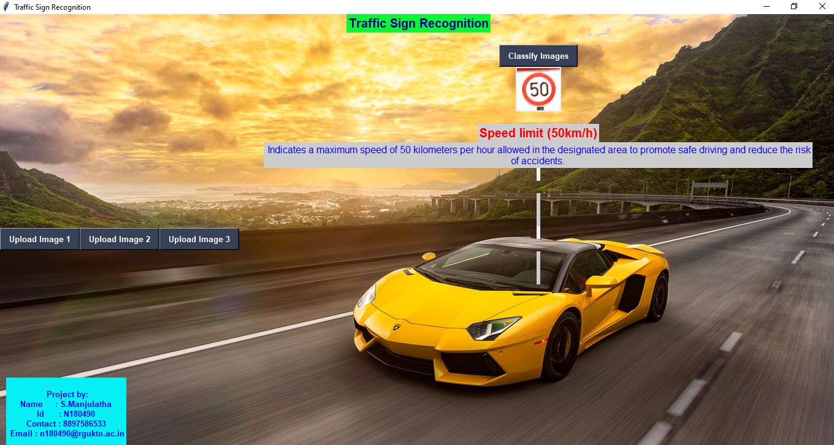
Graphical User Interface

Slide 17
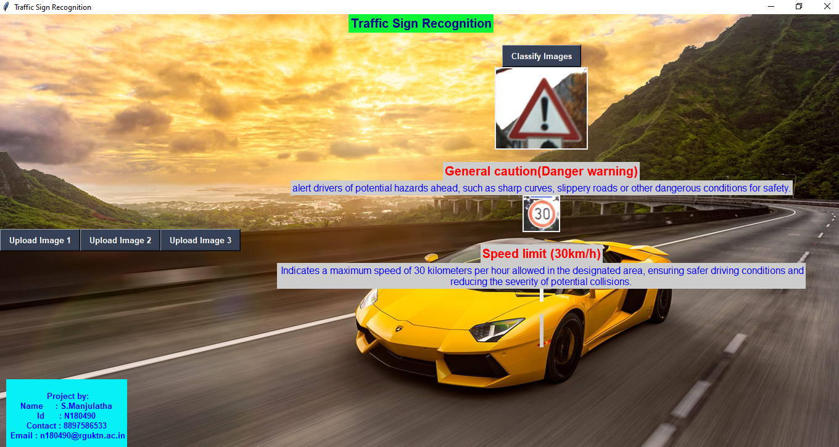
Graphical User Interface

Slide 18
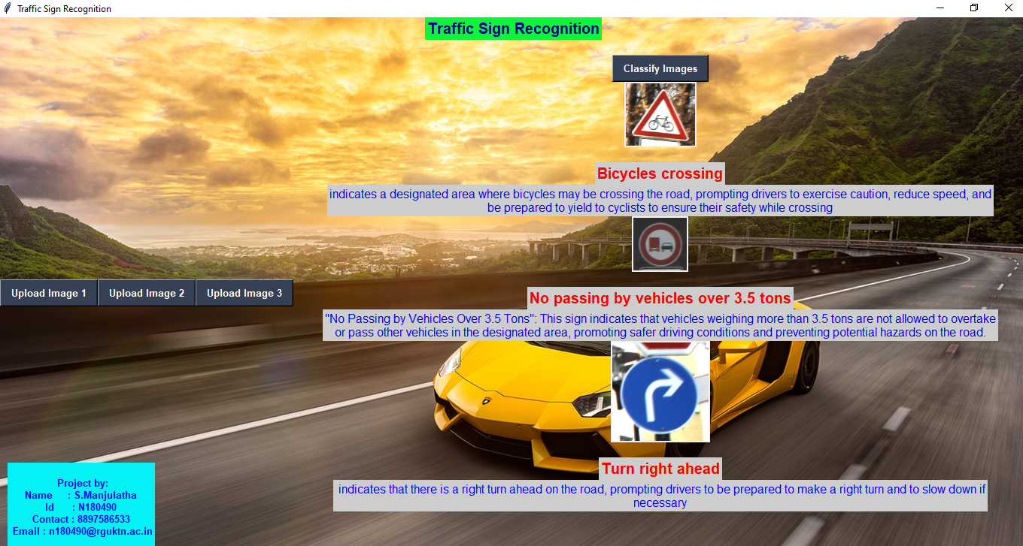
Graphical User Interface

Slide 19
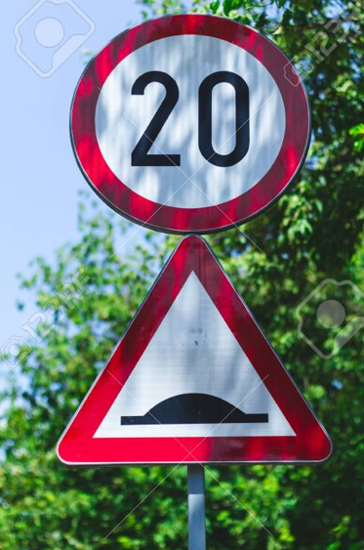
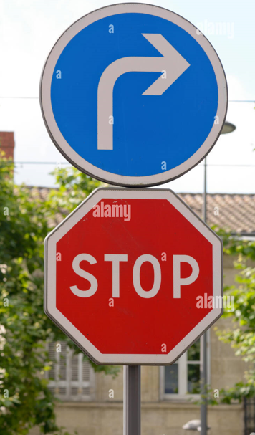
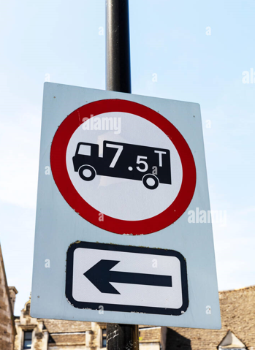
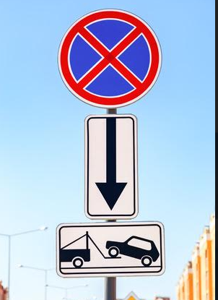

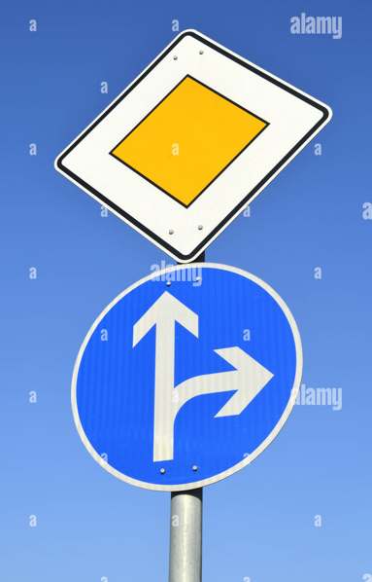
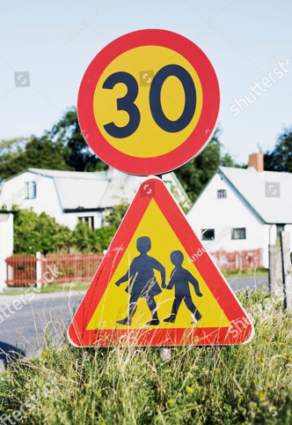
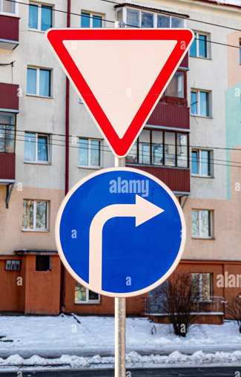
Two Traffic signs

Slide 20
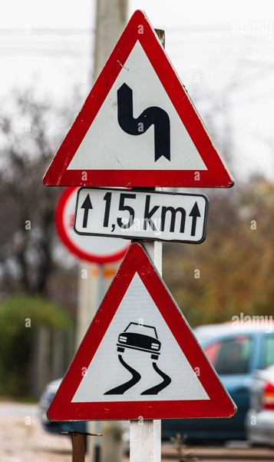
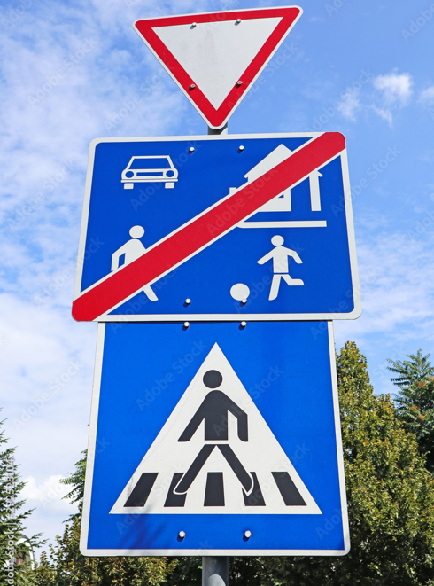
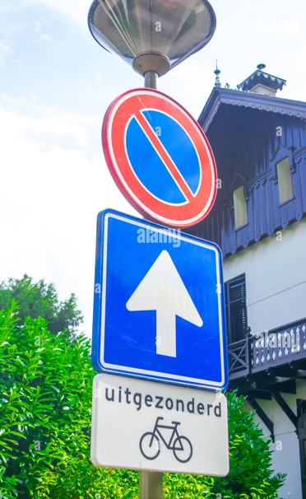
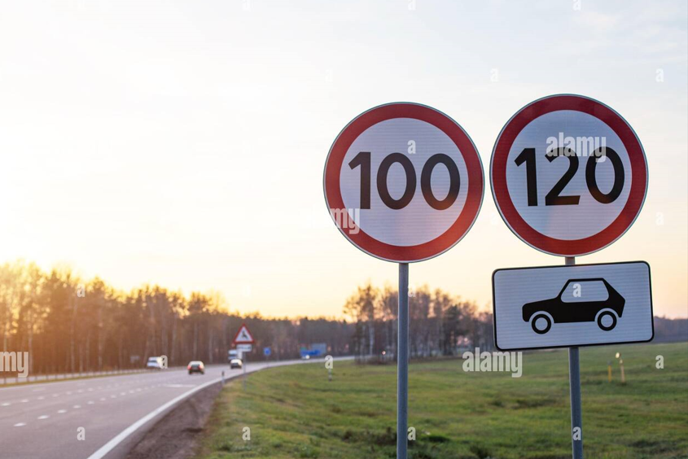

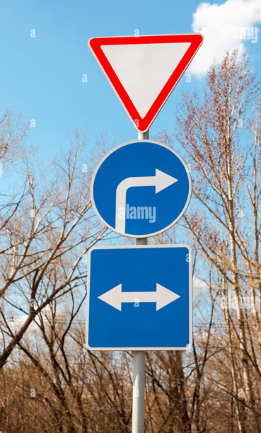
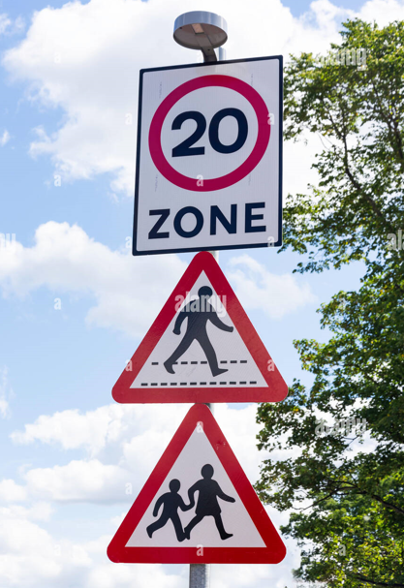
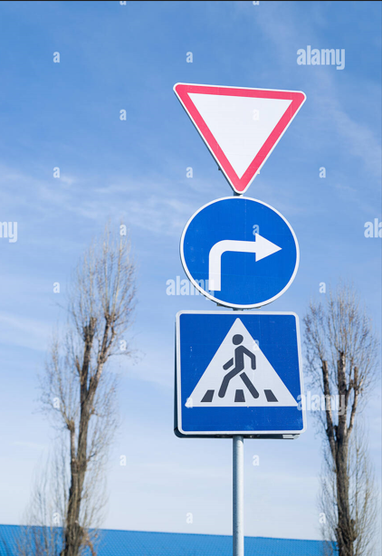
Three Traffic signs

Slide 21
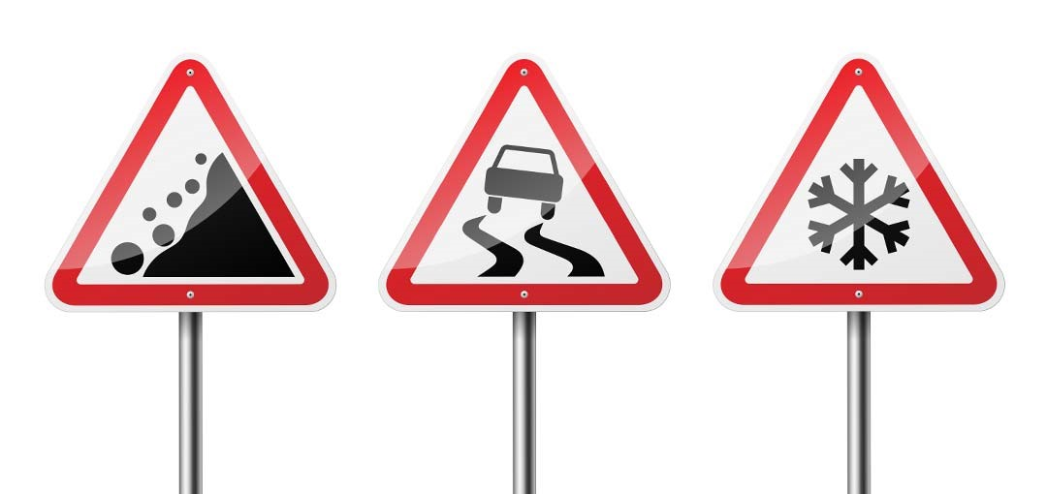
Conclusion
I have proposed an efficient traffic sign recognition method. to the present end, I generalized the traffic sign templates with high accuracy .To achieve practical detection speed, I have explored the best-performing convolutional neural network for recognition considering the characteristics of traffic signs. in some areas there will be one or two or three traffic signs will be there ,in such conditions this project can detect those three traffic signs at a a time. By using the images of traffic signs,this method effectively utilizes strong information of target shapes and recognize the traffic signs in order to reduce road accicidents.

Slide 22
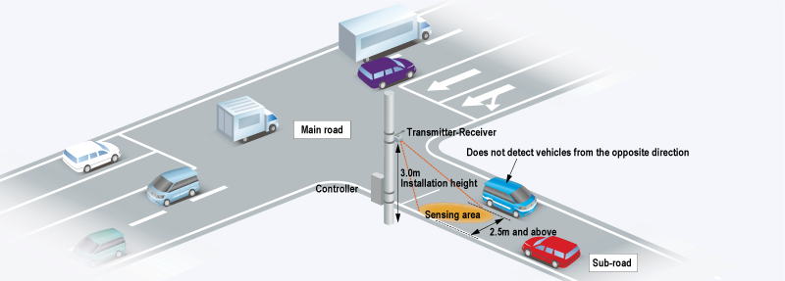
Future Work
With a CNN model achieving 94% accuracy and a graphical user interface in place for displaying the results, the future scope of the traffic signal recognition project could involve real-world deployment in smart city infrastructures to optimize traffic flow and enhance road safety. The project can also explore multi-modal recognition by integrating additional sensors for improved performance in diverse weather and lighting conditions. Furthermore, continuous data collection and analysis can be utilized to further enhance the model's accuracy and responsiveness over time.

Slide 23
References
An Automatic Traffic Sign Detection and Recognition System supported Colour Segmentation, Shape Matching, and SVM 2015.
CNN Design for Real-Time Traffic Sign Recognition Alexander Shustanova 2017
C. Liu, F. Chang, and C. Liu, “Occlusion-robust traffic sign detection via cascaded colour cubic feature,” IET Intell. Transp. Syst., vol. 10,no. 5, pp. 354–360, 2015
A. Møgelmose, D. Liu, and M. M. Trivedi, “Detection of U.S. traffic signs,” IEEE Trans. Intell. Transp. Syst., vol. 16, no. 6, pp. 3116–3125, Dec. 2015.
O. Dabeer et al., “An end-to-end system for crowdsourced 3D maps for AL vehicles: The mapping component,” in Proc. IEEE/RSJ Int. Conf. Intell. Robots Syst., Sep. 2017, pp. 634–641.
A. Gudigar, C. Shreesha, U. Raghavendra, and U. R. Acharya, “Multiple thresholding and subspace based approach fordetection and recognition of traffic signs,” Multimedia Tools Appl., vol. 76, no. 5, pp. 6937–6991, 2017
Traffic-Sign Detection and Classification Under Challenging Condition, Uday Kamal 2018.

Slide 24

Submitted by : -
N180490 – S.Manjulatha

